Slide 1
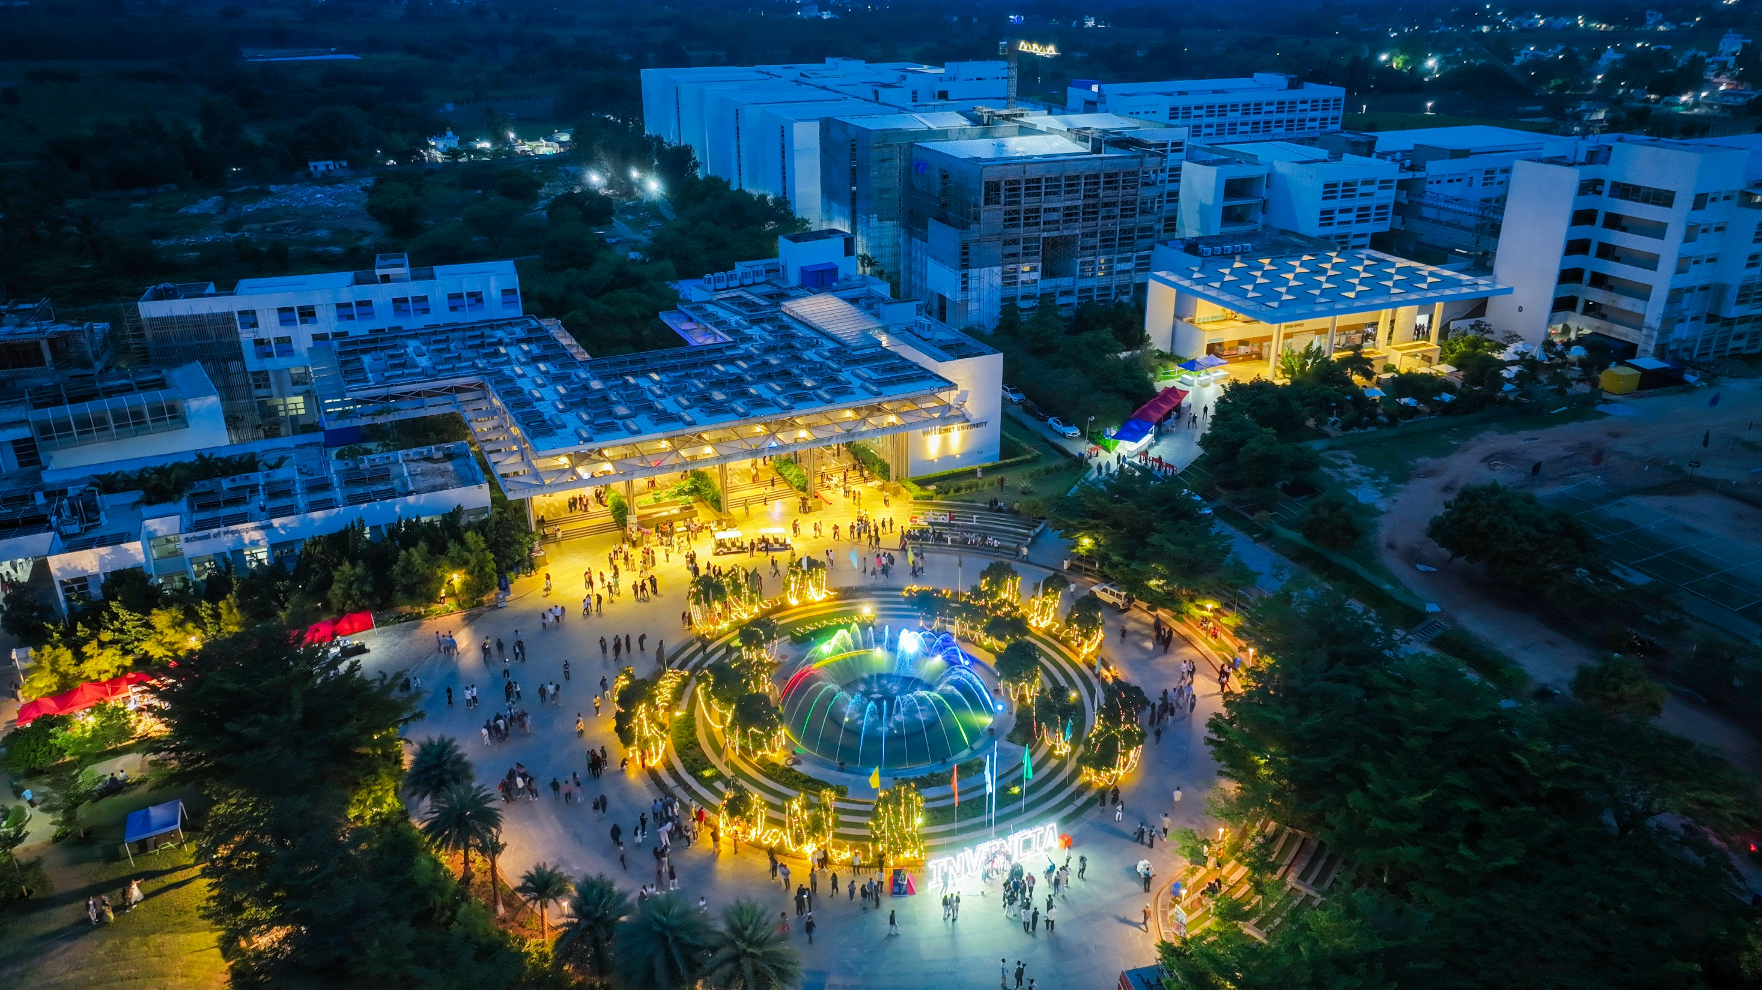

1
Presidency
Presidency
School of Engineering

Slide 2
Department of
Electronics and Communication Engineering

Slide 3
Basics of Electronics and Communication Engineering (ECE3107)
L-T-P-C: 3-0-0-3
By
Dr. K. Gowri
Assistant Professor – Senior Scale
Department of Electronics and Communication Engineering
Presidency University, Bengaluru

Slide 4
MODULE 2
Vision algorithms and applications:
Transforming sensor reading, Mapping Sonar Data, aligning laser scan measurements - Vision and Tracking: Following the road, Iconic image processing, Multiscale image processing
Video Tracking - Learning landmarks: Landmark spatiograms, K-means Clustering, EM Clustering.

Slide 5
2.1 Transforming sensor reading
Introduction:
The presence of sensors in the ubiquitous environment has led to the production of an enormous amount of data.
These sensors belong to diverse categories including planar pressure, thermal, optical, acoustic, and proximity modalities.
They provide information for activity recognition and context-aware models that could be used for a wide range of applications such as automatic monitoring in the smart environment and wellness scene, computer-human-interaction, user experience, etc.

Slide 6
2.1 Transforming sensor reading
There has been extensive research on wearable and pervasive sensors, which record and sense data in the context of human activities; ranging from physical activities (running, sleeping, walking, etc.), such as monitoring gym exercises, analyzing gait patterns, to biological activities (breathing, eating, etc.), such as breathing detection, eating and drinking arm gesture detection.
The task of extracting useful information from the raw sensor data has been performed using various machine learning and data mining techniques.

Slide 7
2.1 Transforming sensor reading
Usually, when the raw sensor data is concerned, the feature extraction is done using statistical methods involving the calculation of the mean, standard deviation, maximum and minimum values.
These features have proven to be quite reliable in tasks related to classification, recognition and segmentation.
Deep learning, Convolutional neural networks (CNN), Recurrent neural networks (RNN) – popular in achieving superhuman accuracy on image classification tasks.

Slide 8
2.1 Transforming sensor reading
Both, CNN and RNN have been used in combination to create systems which are capable of understanding images, and to provide temporal context to these individual images.
Limitations: requirement of large amounts of labeled data to facilitate the training of these very deep networks.
While the computer vision community has facilitated this requirement with large labeled datasets, such as, the ImageNet and MS-COCO datasets for object recognition, classification, detection and captioning; for various other tasks not many labeled datasets exist.

Slide 9
2.1 Transforming sensor reading
The above-mentioned limitation can be bypassed by performing transfer learning, i.e., using labeled data from one domain and transferring the learned knowledge to a target domain.
Transfer learning involves using the knowledge acquired on a specific task, and adapting this knowledge to a different, but related task.
A common scenario for transfer learning involves using a convolutional neural network trained on a very large dataset, and then fine-tuning it on the target dataset which is relatively small in size.

Slide 10
2.1 Transforming sensor reading
A domain is said to be easily visually interpretable if by looking at its visual representation, a human can extract relevant information and sense of the meaning it conveys.
For example, images of everyday objects such as automobiles, animals, landscapes; documents, X-ray, and MRI scan data all belong to the category of easily visually interpretable images.
An average human can easily learn to distinguish between different classes, e.g., several sub-species of animals, or several models of automobiles.
Doctors or radiologists analyze and interpret MRI or X-ray data to detect irregularities in healthy organs.

Slide 11
2.1 Transforming sensor reading
The application of transfer learning on such images is feasible for mainly two reasons.
It is possible due to their nature of being visually meaningful.
There are large datasets from the same domain available within the community to carry out the transfer learning tasks.
However, there exists types of data, such as sensor data, which are not easily visually interpretable, and it is unclear if it would be possible to visually interpret them.
Not visually interpretable data can be, for example, position updates of moving objects in location-based services, fluctuations in the stock market, medical experimental observations, or streaming sensor data.

Slide 12
2.1 Transforming sensor reading
Sensors:
Over the past decades, the availability of sensors has increased substantially and enabled makers and designers to prototype interactive objects rapidly and at low cost.
However, this large variety of components also comes with the challenge of selecting the right sensor from many similar components to find the one that best fits the use case at hand.
Since each sensor has its own specification, understanding what each sensor can sense and how it will work on a prototype can be a time-consuming process.

Slide 13
2.1 Transforming sensor reading
Limitations of reading sensor data:
Extracting information from a datasheet can be cumbersome and confusing since the sensing information may be buried among the chip design, schematic, and other technical aspects.
Datasheets are not standardized, which makes comparing sensors with each other a difficult task.
Since datasheets are text documents, it can be hard to picture what sensors can sense when placed on a prototype.

Slide 14
2.1 Transforming sensor reading
Different Stages of Prototyping with Sensors
Sensor Specifications from Datasheet
Sensor Data Overlay over the Physical Prototype via AR
Live and Recorded Sensor Data Visualization

Slide 15
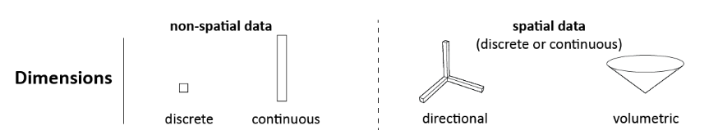
2.1 Transforming sensor reading
Library of visualization primitives:
Dimensionality:
We represent discrete data as a point and continuous data as a bar.
We represent directional data as bars in different directions.
For volumetric data, we display the data as a 3D volumetric shape (e.g., a cone or hemisphere). Dimensional information is rendered as a black outline with no infill.

Slide 16
2.1 Transforming sensor reading
Range
To visualize the range of a sensor, we use the min/max values from the datasheet as the bounds of the visualization.
For continuous non-spatial and directional data, we define the lower bound of the visualization to be equal to the minimum value and the upper bound of the visualization to be equal to the maximum value specified in the datasheet.
For spatial data, the visualization shows the lower and upper bounds of the sensing volume in the size as specified in the datasheet.

Slide 17
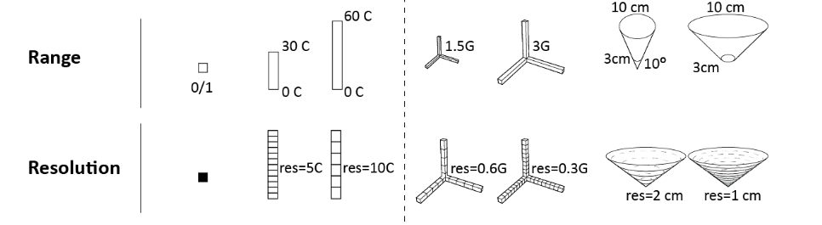
2.1 Transforming sensor reading
Resolution:
We visualize resolution by splitting the bar or volume into segments, with smaller segments representing higher sensor resolutions than larger segments.
We compute the segment size by dividing the sensor’s output bit resolution by the range of the sensor.

Slide 18
2.1 Transforming sensor reading
Sensor Values
We visualize live sensor values by filling in the point, bar, or volume.
For discrete values, if a ’zero’ is read, the point is rendered in 0% opacity and if a ’one’ is read, it is rendered in 100% opacity.
Makers can differentiate between a ’zero’ reading and ’no data’ using the text label that shows the current value.
For continuous values, the larger the received sensor values, the more of the bar or the volume is rendered in 100% opacity.

Slide 19
2.1 Transforming sensor reading
Textual information
We use labels to display the range (min/max), the resolution, and the current sensor value.
For directional data, we also label the axes information, and for volumetric data, we label the angle of the feld of view.
Makers can choose in the user interface which information they want to display.

Slide 20
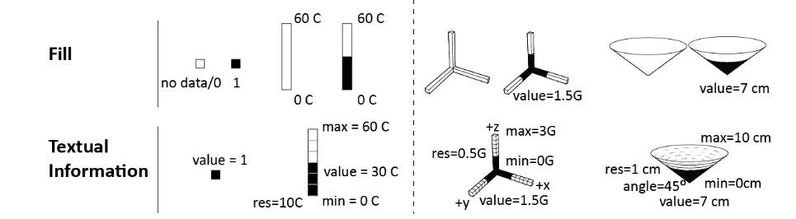
2.1 Transforming sensor reading

Slide 21
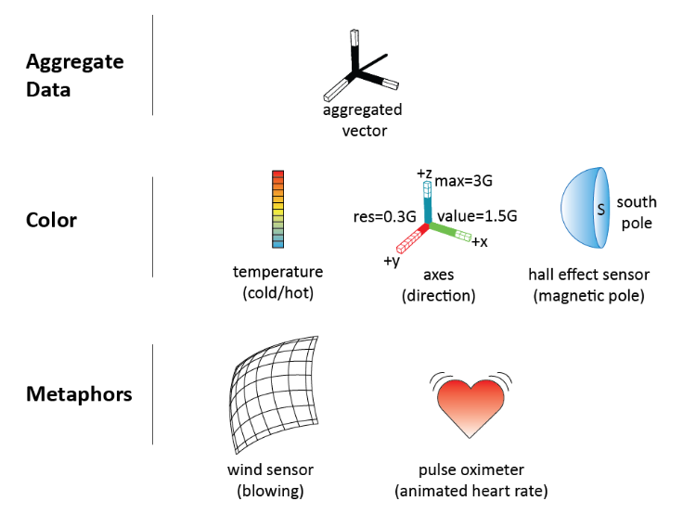
2.1 Transforming sensor reading
Additional Visualizations Attributes:

Slide 22
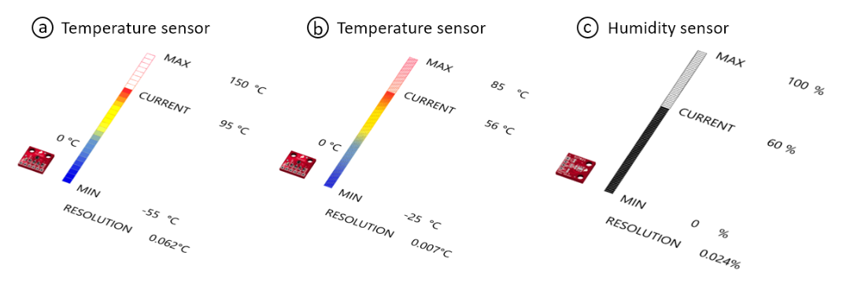
2.1 Transforming sensor reading

Slide 23
2.1 Transforming sensor reading
Steps to transform sensor reading:
Loading Sensor Information from Sensor Database
Visualizing Sensor Data
Augmented Reality visualization
Reading Live Sensor Values
Recording Sensing Data
Sensing Area Overlap

Slide 24
2.2 Mapping SONAR Data
Advances in technology have since enabled the deployment of Remotely Operated Vehicles (ROVs) and Autonomous Underwater Vehicles (AUVs), which have revolutionized ocean exploration by automating complex tasks and reducing dependence on human operators.
Despite these technological advancements, underwater navigation and object detection remain challenging due to the limitations of optical sensors.
Water turbidity, light attenuation, and scattering severely degrade visual data quality, making camera-based imaging unreliable in most sub-sea operations.

Slide 25
2.2 Mapping SONAR Data
Sonar technology has emerged as a viable solution for underwater detection and navigation, as it operates using acoustic waves that can penetrate murky waters and function independently at ambient lighting conditions.
Sonar systems are generally categorized into single-beam and multi-beam types.
Multi-beam sonars provide extensive spatial coverage and high-resolution 3D reconstructions, but their cost and complexity limit accessibility for smaller research or commercial platforms.

Slide 26
2.2 Mapping SONAR Data
Sonar technology has emerged as a viable solution for underwater detection and navigation, as it operates using acoustic waves that can penetrate murky waters and function independently at ambient lighting conditions.
Sonar systems are generally categorized into single-beam and multi-beam types.
Multi-beam sonars provide extensive spatial coverage and high-resolution 3D reconstructions, but their cost and complexity limit accessibility for smaller research or commercial platforms.

Slide 27
2.2 Mapping SONAR Data
Single-beam sonars—such as the Blue Robotics Ping360—employ a mechanically rotating transducer to sweep across a specified range, generating 2D polar representations of the surrounding environment.
The sonar scanned the environment incrementally, recording intensity values within a range of 0-255 at each angular position.
These intensity values represent the strength of acoustic reflections from objects within the field of view.
The raw Ping360 sonar output is inherently represented in polar coordinates (range versus bearing).

Slide 28
2.2 Mapping SONAR Data
Each beam corresponds to a specific bearing angle, and each range bin encodes the reflected amplitude.
For interpretability and machine learning analysis, these polar data are converted into Cartesian occupancy maps, where both axes rep- resent spatial distance.
Signal filtering is used to ensure only valid data points within the useful scanning range were retained for analysis.
Following this, a statistical threshold approach was applied to further refine the region of interest (ROI) .
This approach ensured the removal of noise while preserving significant reflections from objects.

Slide 29
2.2 Mapping SONAR Data
The data is manually inspected and transformed into polar coordinates and converted into a grayscale image format for training the deep learning networks.
With this types of input, the model learns to separate objects from the back- ground based on intensity variations detected by the sonar.

Slide 30
2.3 Aligning LASER Scan Measurements
Precise localization is a prerequisite for many autonomous systems, such as robotics, unmanned aerial vehicles, etc.
Also, indoor positioning is an especially challenging problem, where localization cannot be achieved by GPS due to the satellite signal being greatly attenuated.
While the traditional radio-based indoor positioning technologies, such as Bluetooth, Wi-Fi, Radio-frequency Identification (RFID) and ultra-wideband (UWB), still have some disadvantages in terms of low accuracy, high latency, electromagnetic interference or high hardware cost.

Slide 31
2.3 Aligning LASER Scan Measurements
The localization technology based on visible light communication (VLC), which is referred as visible light positioning (VLP), has attracted intensive attention as it can provide high accuracy positioning based on the existing lighting infrastructure.
The modulated LED broadcasts its unique identity (ID) via switching at a high frequency imperceptible to the human eye, but which can be recognized by photodiodes (PD) and rolling shutter effect (RSE) cameras.
The LED-ID can be mapped/modulated once for all since they are normally fixed and not easily vulnerable to environmental changes.

Slide 32
2.3 Aligning LASER Scan Measurements
Sensors are imperfect, and their measurements are prone to errors.
Sensors should be carefully mounted and aligned in order for your application to receive optimum results.
Navigation denotes the robot’s ability to determine its own position in its frame of reference and then to plan a path towards some goal location.
The most important consideration to reduce measurement error is aligning the sensor beam so that it is parallel to the dimension to be measured.

Slide 33
2.3 Aligning LASER Scan Measurements
The easiest example to describe is height.
If we want to measure the height of an object with a ruler, you would want that ruler to be perfectly up and down.
If the ruler weren’t perfectly up and down, we’d expect an error with your measurement.
It’s the same with the laser beam on our sensors.
We’d ideally want to align the beam so that it is perfectly up and down to measure height.
Any deviation from that alignment would introduce an error in the measurement.

Slide 34
2.3 Aligning LASER Scan Measurements
While truly perfect alignment is impossible, with care and a well-made fixture or alignment bracket, we often can get the alignment accurate enough to reduce the alignment error to significantly less than the sensor’s error.
The angle between the beam and the surface of the target can also be a source of error.

Slide 35
2.3 Aligning LASER Scan Measurements
The reasons for the laser beam of the sensor is to strike the target surface as close to perpendicular as possible.
While the laser spot from our sensors often looks like a single point on the target, it does have a diameter.
# The more angled the target is, the more the spot stretches out on the target.
#This does make it more difficult for the sensor to know where the center of that spot is, and that can cause errors.

Slide 36
2.3 Aligning LASER Scan Measurements
An angled target will usually reflect more light away from the sensor’s detector.
# The less light the detector gets, the harder it is for the sensor to distinguish the measurement from other light noise.
# That can reduce the measurement accuracy, increase the measurement time, or both.
# This problem increases with the shininess of the target.

Slide 37
2.3 Aligning LASER Scan Measurements
3. An angled or rough target that is shiny can cause the opposite problem — direct reflection into the detector.
# If there is “specular” or direct reflection, that shows up on the detector as a second peak that has no relation to the distance.
# This can result in measurements that are completely incorrect or keep the sensor from offering a measurement at all.

Slide 38
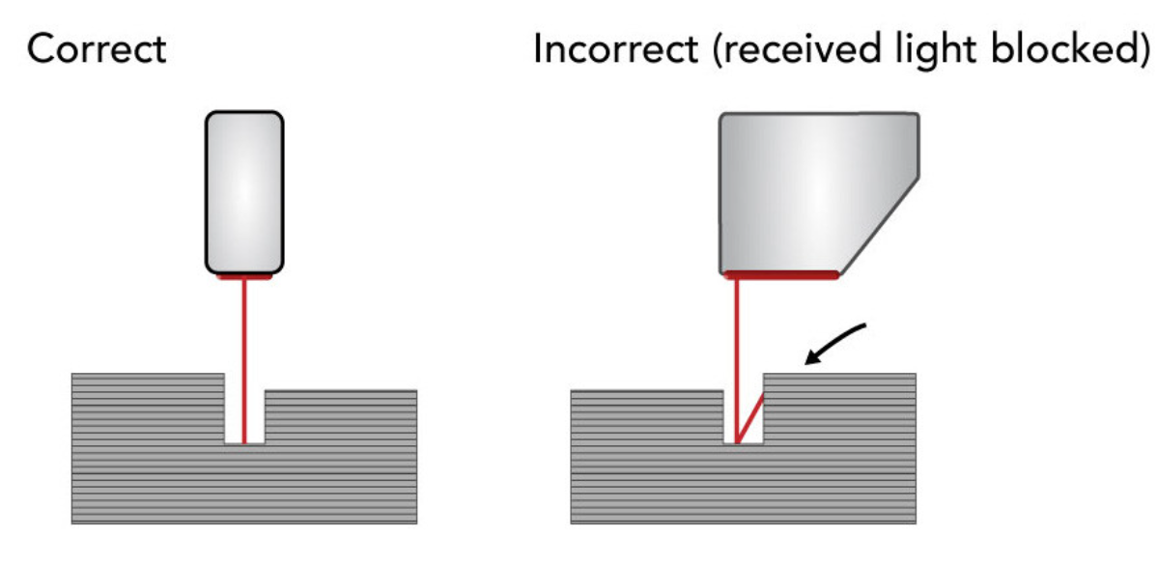
2.3 Aligning LASER Scan Measurements

Slide 39
2.3 Aligning LASER Scan Measurements
3D laser scanner measurement:
It is an advanced method for precise three-dimensional measurement of objects using laser line triangulation sensors, also known as laser scanners.
This technology enables the accurate determination and comparison of measured values such as length, width, height, angle, radius, flatness, parallelism, diameter, defect sizes and more.
Unlike traditional 2D image processing with cameras, 3D laser scanner measurement enables a three-dimensional representation of an object.

Slide 40
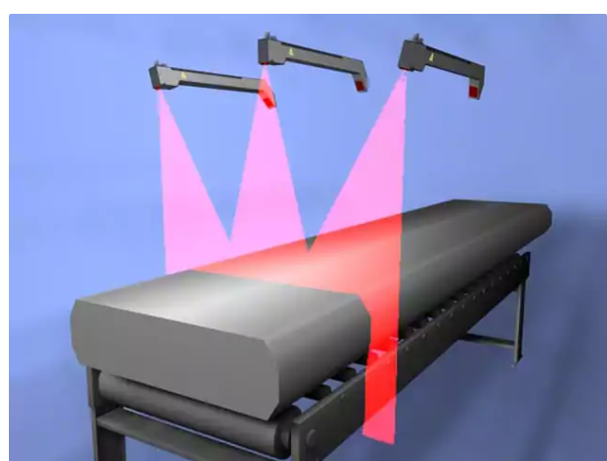
2.3 Aligning LASER Scan Measurements
3D laser measurement of an aluminium block

Slide 41
2.3 Aligning LASER Scan Measurements
Typical industries and sectors where 3D laser scanner measurement is used include:
Metalworking
Mechanical Engineering
Welding technology
Automotive
Battery manufacturing
Aerospace
Smartphone manufacture

Slide 42
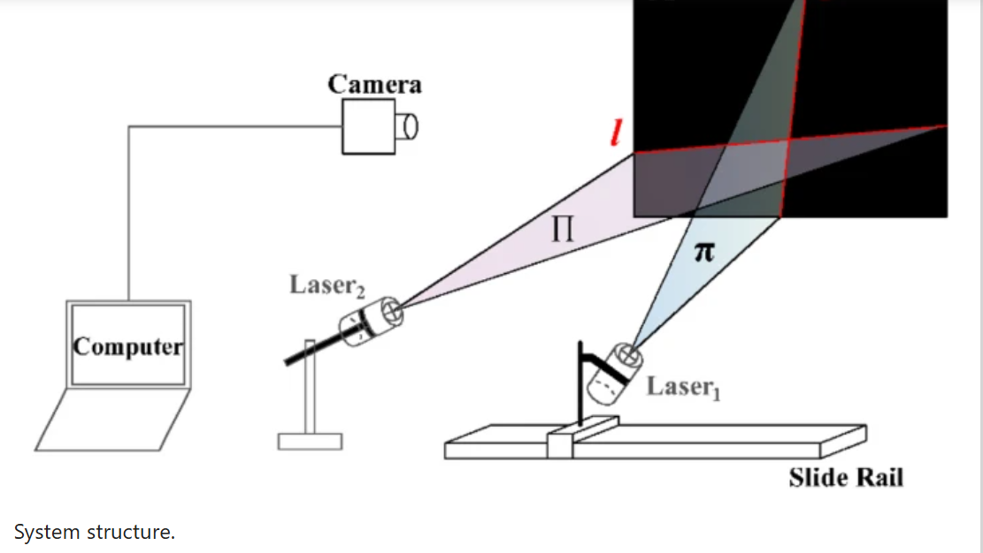
2.3 Aligning LASER Scan Measurements
3D laser measurement

Slide 43
2.4 Vision and Tracking
The sense of vision is a powerful and dominating sense in humans.
A typical approach is to use a video camera as a visual sensor.
The subjective experience of understanding the content of a visual scene is often as simple as opening one’s eyes — there seems to be little or no conscious effort involved in perceiving a three-dimensional world filled with objects and surfaces both near and far.

Slide 44
2.4 Vision and Tracking
The perception is so effortless that it is possible, even typical, to underestimate the difficulty of duplicating the feat with a video camera.
The lack of effort also belies the amount of neural hardware that goes into this visual illusion.
Extracting information from a video sequence is a computationally intensive and difficult problem.
While the field of computer vision continues to make important advances, it would be premature to consider it a problem solved.

Slide 45
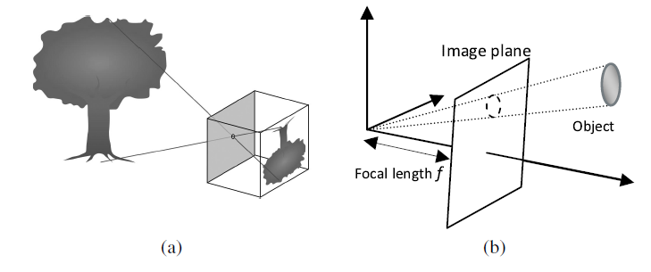
2.4 Vision and Tracking
Fig. 2.4.1 Pin-hole camera (a) and its mathematical model (b).

Slide 46
2.4 Vision and Tracking
Issues that make computer vision difficult.
1. Information is lost in the 3D to 2D transformation.
A pin-hole camera is a closed container with a small hole on one side.
Light rays enter through the hole, illuminating the back wall with the color of the object from which they were reflected and thereby painting an image on the wall.
The image is upside-side down and reversed because of the path the light rays travel.
This relationship between the object and its image is often modeled mathematically as a perspective projection (shown in fig 2.4.1).

Slide 47
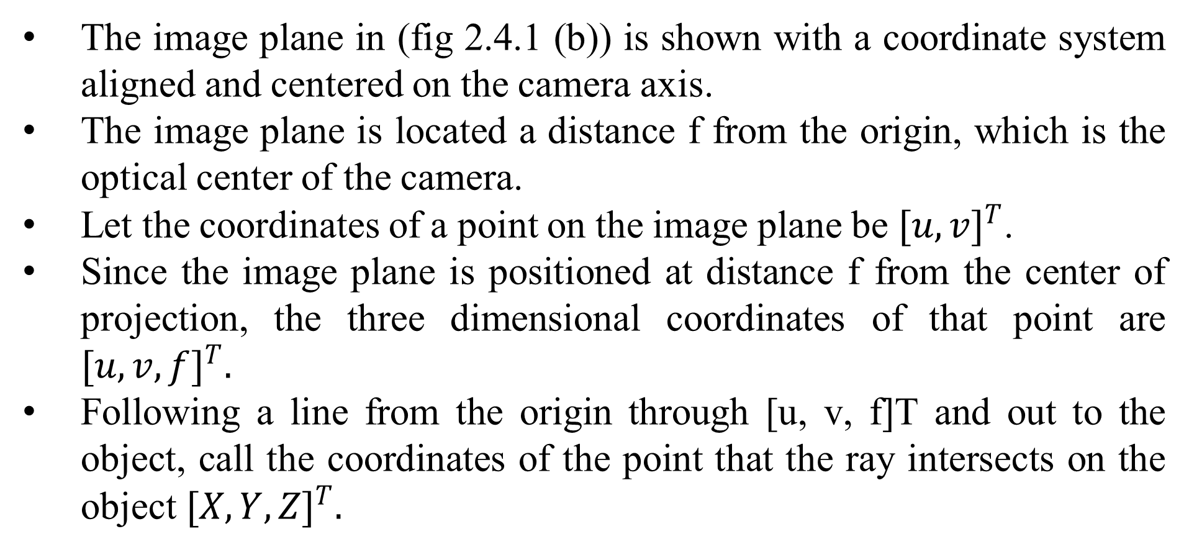
2.4 Vision and Tracking
The image plane in (fig 2.4.1 (b)) is shown with a coordinate system aligned and centered on the camera axis.
The image plane is located a distance f from the origin, which is the optical center of the camera.
Let the coordinates of a point on the image plane be ${[u,v]}^{T}$.
Since the image plane is positioned at distance f from the center of projection, the three dimensional coordinates of that point are ${[u,v,f]}^{T}.$
Following a line from the origin through [u, v, f]T and out to the object, call the coordinates of the point that the ray intersects on the object ${[X,Y,Z]}^{T}.$

Slide 48
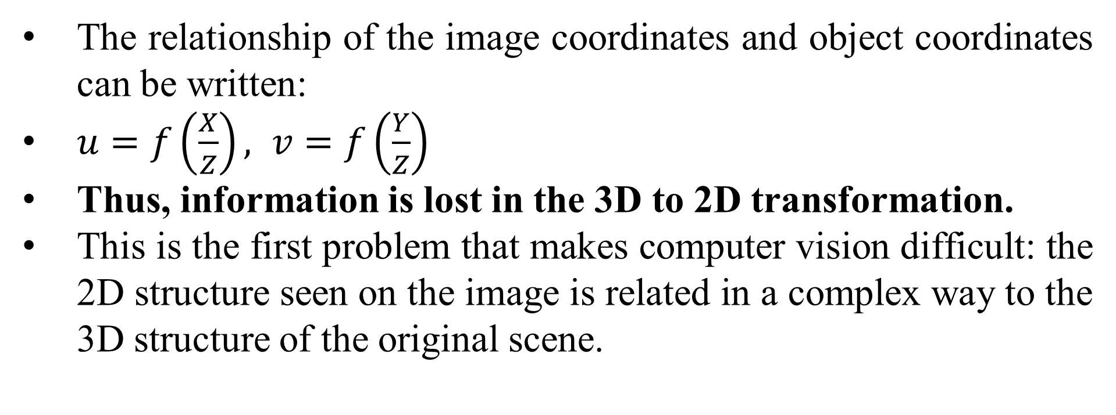
2.4 Vision and Tracking
The relationship of the image coordinates and object coordinates can be written:
$u=f\left(\frac{X}{Z}\right), v=f\left(\frac{Y}{Z}\right)$
Thus, information is lost in the 3D to 2D transformation.
This is the first problem that makes computer vision difficult: the 2D structure seen on the image is related in a complex way to the 3D structure of the original scene.

Slide 49
2.4 Vision and Tracking
2. To a computer, the image has to be understood pixel by pixel and clearly separable into regions.
An image is represented on a computer as an array of pixels.
Each pixel corresponds to the intensity and the color of light integrated over a small area of the image.
A pixel can be represented as a single value, corresponding to the total intensity of light in that area.
It can also be represented as a n-tuple of values in some color space.
A typical color space is RGB (Red-Green-Blue).

Slide 50
2.4 Vision and Tracking
A large variety of colors can be represented by a linear combination of the ‘standard’ red, green and blue primary colors- the coefficients in this linear combination are the pixel’s RGB values.
These will often be numbers between 0 and 1.
For example: the RGB value (1, 0, 0) would denote a pixel that is 100% red; (0.25, 0.25, 0) would be a pixel with 25% red and 25% green, a dark yellow; (0, 0, 0) would be black; and (1, 1, 1) would be white.

Slide 51
2.4 Vision and Tracking
Figure 2.4.2 illustrates a second difficulty in computer vision.
To a human, a scene such as Figure 2.4.2(b) consists of some objects —mountains, trees, river — positioned in the scene relative to each other.
To a computer, the image has to be understood pixel by pixel, as in Figure 2.4.2(a) and the scene viewed at this scale is far less clearly separable into regions corresponding to objects.

Slide 52
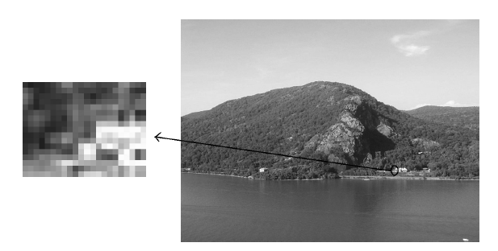
2.4 Vision and Tracking
Fig 2.4.2 (a) Close up (b) of a section of a digital image.

Slide 53
2.4.1 Vision and Tracking: Following the road
Consider the problem illustrated in Figure 2.4.3
This figure shows a robot using its visual sensor to navigate along a path delineated by white lines on the ground.
The problems involved are to first identify the lanes (the white lines in the image) and then determine where these lines are in space with respect to the robot.
We will look at some of the computational steps in road following and how this might be done on a cluster.
A robot such as the Pioneer 3-AT shown in Figure 2.4.3(a) does not typically carry an onboard cluster.

Slide 54
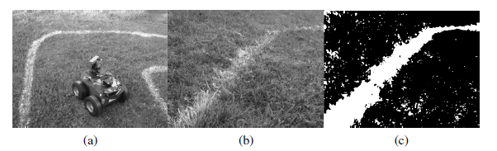
2.4.1 Vision and Tracking: Following the road
Figure 2.4.3: (a) Robot lane following (b) lane closeup and (c) thresholded Cb component of closeup.

Slide 55
2.4.1 Vision and Tracking: Following the road
However, it is not unreasonable to expect that such machines will carry multiprocessor, multicore computers in the near future.
More sophisticated robots, such as Junior, the Stanford University entry in the DARPA Urban Challenge already carry multiprocessor, multicore systems onboard.

Slide 56
2.4.2 Vision and Tracking: Iconic image processing
Always we need to preprocess the image at the pixel level.
The noise introduced into the image by the camera or random lighting effects may need to be reduced.
Aspects of the image such as edges or regions of color may need to be enhanced.
These operations consider the image only to be a collection of pixels, and operate pixel by pixel, (or pixel by small regions of pixels).
This kind of processing is called image processing to distinguish it from operations the iconic at attempt to identify 3D structure, objects or shapes in the image.

Slide 57
2.4.2 Vision and Tracking: Iconic image processing
Iconic image processing is typically more suited to fine grain, massively parallel, single instruction multiple data architectures.
However, as long as the image information can be moved efficiently enough, cluster processing of images can also be effective.
One approach to avoiding image transfer costs is to equip individual nodes in the cluster with separate cameras.
Examples of pixel-based iconic image operation include color space transformations, color filtering, intensity transformations and so forth.

Slide 58
2.4.2 Vision and Tracking: Iconic image processing
For example, the difference between the white lines and the grass background in Fig. 2.4.3 (a) becomes much more apparent when the color space is changed from RGB to the luma-chroma colors space YCrCb.
Subsequently restricted to just the Cb chroma component, and finally thresholded to a binary image.
Thresholding is also a pixel-based iconic image processing operation.
Pixels in the thresholded binary image are set to 1 if the pixels in the original image have a value greater than the threshold value and are set to 0 otherwise.

Slide 59
2.4.2 Vision and Tracking: Iconic image processing
Changes in the lighting of a natural scene are typically not very noticeable to a human observer, but can cause a great deal of difficulty in analysis of images.
A scene might have overall increases or decreases in light intensity due to the time of day or weather conditions.
There may also be shadow effects as lighting sources move due to the time of day, or as objects move in or adjacent to the scene.
Another reason to use YCrCb, rather than RGB, for the analysis of natural images (such as Figure 2.4.3(a)) is that the CrCb chroma (or color) components are less sensitive to changes in light intensity.

Slide 60
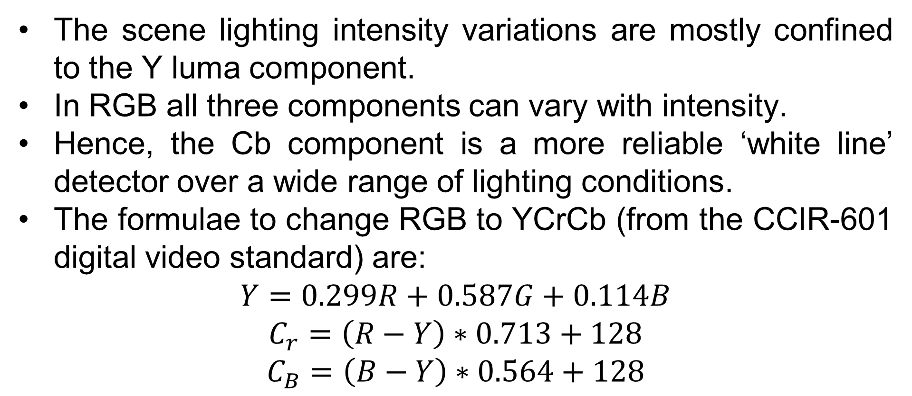
2.4.2 Vision and Tracking: Iconic image processing
The scene lighting intensity variations are mostly confined to the Y luma component.
In RGB all three components can vary with intensity.
Hence, the Cb component is a more reliable ‘white line’ detector over a wide range of lighting conditions.
The formulae to change RGB to YCrCb (from the CCIR-601 digital video standard) are:
$$Y=0.299R+0.587G+0.114B$$
$$C_{r}=\left(R−Y\right)∗0.713+128$$
$$C_{B}=\left(B−Y\right)∗0.564+128$$

Slide 61
2.4.2 Vision and Tracking: Iconic image processing
Notice that there are quite a few isolated white speckles in the image in Figure 2.4.3(c).
These could be reduced by reducing the threshold value.
However, if we do that, we may also reduce the amount of the white line that is visible.

Slide 62
2.4.2 Vision and Tracking: Iconic image processing
Analysis:
Let the time taken to color convert and threshold 1 pixel be χ.
In that case, the serial time to process an n×m image is easily calculated as Ts = nmχ.
The parallel communication time is composed of the time to scatter the color image strips and to gather the thresholded image back again.
The time to scatter the image strips from the root to each processor is given by λlog p + 3nm(p − 1)/pβ.

Slide 63
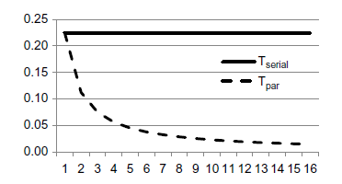
2.4.2 Vision and Tracking: Iconic image processing
The time to gather the result image back to the
root is λlog p + nm(p − 1)/pβ.
The parallel calculation time is nmχ/p.
Figure 2.4.4: Performance graph for parallel pixel-based operations for 640 × 480 image (λ = 3μs, β = 1Gbps, χ = 730 ns).

Slide 64

2.4.2 Vision and Tracking: Iconic image processing
The total parallel time is therefore,
$$T_{p}=2λ\log{p+\frac{4nm(p−1)}{pβ}+\frac{nmX}{p}}$$

Slide 65
2.4.2 Vision and Tracking: Spatial pixel operations
There is an important class of pixel-based operations that involves looking at pixels in a small region of the image.
One such operation, for example, calculates the value of a pixel by averaging the values of the eight pixels that surround that pixel.
When this is applied to each pixel in an image the result is a blurring or smoothing effect on the image.
Figure 2.4.5(a) shows the lane close-up view from Figure 2.4.5.
Figure 2.4.5(b) shows the results of a blurring operation performed on the lane close-up image.

Slide 66
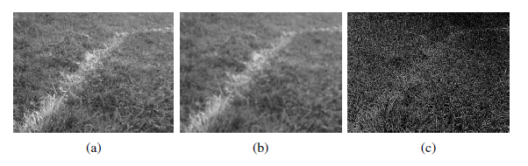
2.4.2 Vision and Tracking: Spatial pixel operations
Figure 7-5: (a) Original image; (b) smoothed; (c) edges.

Slide 67
2.4.2 Vision and Tracking: Spatial pixel operations
Another useful spatial operation is one that sharpens the image (e.g., Figure 2.4.5(c)).
In this case, the central pixel of the neighborhood, is the sum of the differences between the central pixel’s original value and the value each of its eight neighbor pixels.
A convenient way to express spatial operations of this sort is as a convolution operation.
The convolution operation makes use of a convolution kernel G, a q × r matrix.
Typically q = r, and r n, r m, where n ×m are dimensions of the image I.

Slide 68

2.4.2 Vision and Tracking: Spatial pixel operations
No matter what the kernel contains, the convolution H is always defined for each point (x, y) in the image I as:
Fig. 2.4.6 shows a sharpening kernel and a portion of an image.
The kernel is applied to each pixel in succession starting at the top left and working to the bottom right.

Slide 69
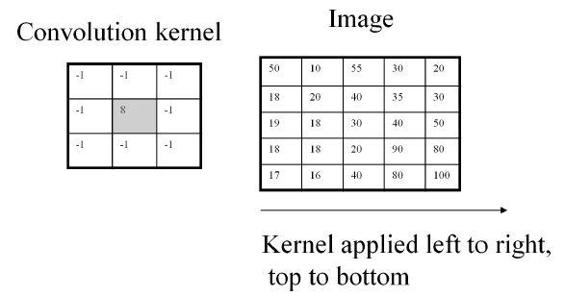
2.4.2 Vision and Tracking: Spatial pixel operations
Figure 7-6: 3 × 3 Image convolution example.

Slide 70
2.4.2 Vision and Tracking: Spatial pixel operations
The pixel value at (x, y) is replaced by the sum of the product of the (i, j) element of the kernel with the (x + i −r/2, y + j − 1/2) pixel of the image for all i and j.

Slide 71
2.4.3 Vision and Tracking: Multiscale image processing
There is an advantage to inspecting an image at several scales, because the objects in an image can vary in apparent size due to visual perspective.
It is useful to combine the results of applying pixel-based image operations at several different image scales.
Consider the three images shown in Figure 2.4.8.
These show the result of processing the scene in Figure 2.4.3(a) with a pixel-based edge operation, an operation that identifies the intensity changes that typically occur at the edges of objects or color regions in an image and which can also be done using convolution.

Slide 72
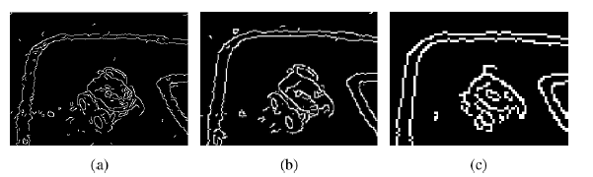
2.4.3 Vision and Tracking: Multiscale image processing
Figure 7-8: Multiscale edge operations on the scene in Figure 7-3(a).

Slide 73
2.4.3 Vision and Tracking: Multiscale image processing
The identified edges show up as white pixels in these images.
The operation was performed with the same kernel size on the original sized image (the leftmost image in Figure 2.4.8), then on an image with half the height and width dimensions of the original (the second image on the left), and so forth, from left to right.
The result images have all been resized identically in Figure 2.4.8 for ease of comparison.

Slide 74
2.4.3 Vision and Tracking: Multiscale image processing
The result images have all been resized identically in Figure 7-8 for ease of comparison.
The image on the left shows the most detailed breakdown of edges: details of the wheels of the robot are visible as is texture along the white lane lines.
The image on the right the least detail: the robot is visible mainly as a rectangular region and the white line lines are devoid of internal detail.

Slide 75
2.4.3 Vision and Tracking: Multiscale image processing
A number of multiscale processing operations have been developed.
SIFT features (Scale Invariant Image Transform features) use a multiscale measurement to identify image features that are unique across a range of scales, image rotations and translations.

Slide 76
2.4.3 Vision and Tracking: Multiscale image processing
Partitioning
The serial implementation of a multiscale image operation would proceed by processing each scaled image in turn.
Let there be s scales.
The full sized image will be n rows by m columns.
Each successive image will be half the row size and half the column size of the next larger image.
If the time to process the full size image is nmχ, then the next smaller scaled image will take nmχ/4 and the next smaller will be nmχ/16 and so forth.

Slide 77
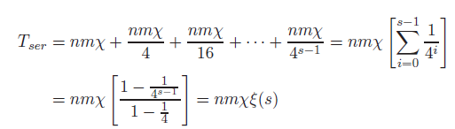
2.4.3 Vision and Tracking: Multiscale image processing
This is a geometric progression with ratio 1/4. The total time taken to process s scales will therefore be,

Slide 78
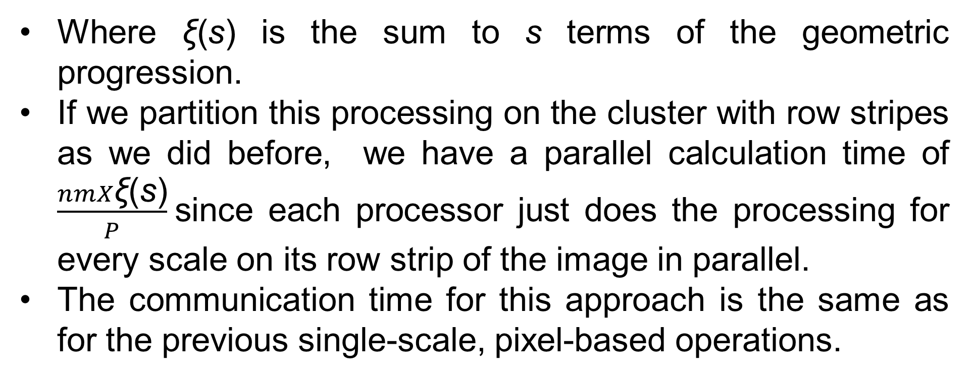
2.4.3 Vision and Tracking: Multiscale image processing
Where ξ(s) is the sum to s terms of the geometric progression.
If we partition this processing on the cluster with row stripes as we did before, we have a parallel calculation time of $\frac{nmX\text{ξ}\text{(}\text{s}\text{)}}{P}$ since each processor just does the processing for every scale on its row strip of the image in parallel.
The communication time for this approach is the same as for the previous single-scale, pixel-based operations.

Slide 79

2.4.3 Vision and Tracking: Multiscale image processing
Each partition will process its scale in parallel, so the calculation time in this case is the time for the largest scale (taking the longest time) to finish:
This is the same as for the simpler row stripe partition, so there is no calculation advantage in partitioning by scale.

Slide 80
2.5 Video tracking- Learning landmarks
Video Tracking
Tracking is the process of monitoring and predicting the motion or location of a target object using sensory information.
A robot may need to track significant aspects of its environment.
For example, a robot operating with a team of other robots may need to track the locations of its team members.
We will look at one approach to visual tracking.
A robot looking at visual landmarks for place recognition.
For example may need to track the relative location of a landmark as the robot moves in the area around the landmark.

Slide 81
2.5 Video tracking- Learning landmarks
Video Tracking
Let’s say the robot is keeping track of targets t1 through tn up to some point in time.
An image taken at the next point in time will yield some candidate target locations, c1 through cm.
Data association is the process of determining which candidates should be associated with which targets.
Let us suppose we have a function s(t, c) that captures how similar the candidate is to the target.

Slide 82

2.5 Video tracking- Learning landmarks
Video Tracking
In Nearest Neighbor data association, the correct data association for each target is chosen as,
Of course, the candidate that appears to be the best at one point in time might later turn out to be incorrect.
Tracking algorithms such as the Joint Probability Data Association Filter (JPDAF) and Multiple Hypothesis Tracking (MHT) address this issue.

Slide 83
2.5 Video tracking- Learning landmarks
Video Tracking
Isard and Blake introduced an approach to tracking called Condensation that is based on particle filters.
A particle filter approach is particularly appropriate for parallel implementation.

Slide 84
2.5 Video tracking- Learning landmarks
2.5.1 Spatial Histograms
A histogram is a measurement of the frequencies with which pixel values appear in an image.
Lets us consider a gray level image, that is, an image with just one color channel.
Let I : P → V be a function that returns the value v ∈ V of a pixel at a location p ∈ P in the image.
The histogram of I captures the number of times each pixel value occurs in the range of the function.
Consider a set B of equivalence classes on V.

Slide 85

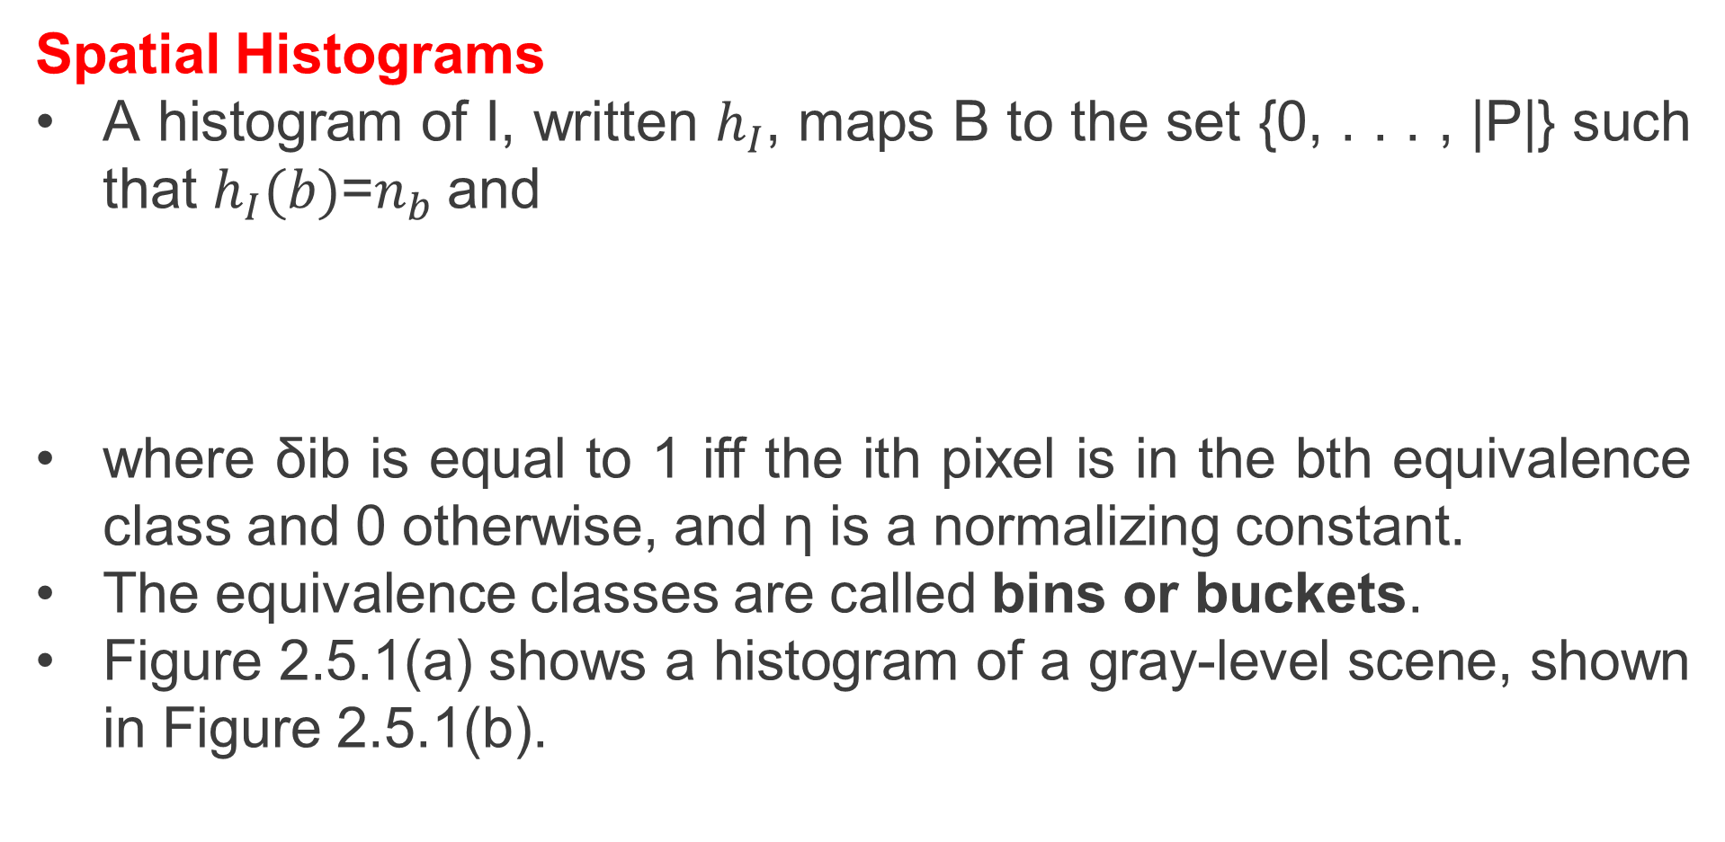
2.5 Video tracking- Learning landmarks
Spatial Histograms
A histogram of I, written $h_{I}$, maps B to the set {0, . . . , |P|} such that $h_{I}(b)$=$n_{b}$and
where δib is equal to 1 iff the ith pixel is in the bth equivalence class and 0 otherwise, and η is a normalizing constant.
The equivalence classes are called bins or buckets.
Figure 2.5.1(a) shows a histogram of a gray-level scene, shown in Figure 2.5.1(b).

Slide 86
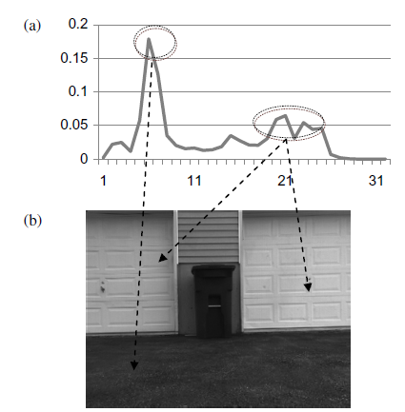
2.5 Video tracking- Learning landmarks
Fig. 2.5.1 (a) Image histogram (freq. vs. pixel value) (b) of gray-level image.

Slide 87
2.5 Video tracking- Learning landmarks
The horizontal axis is the bin number.
This histogram has 32 bins (so each bin covers a range of 8 consecutive pixel values).
The vertical axis is the normalized frequency.
The large peak is due to the dark ground in the bottom of the image in Figure 2.5.1(b).
The two smaller peaks are the bright garage doors in the image.
A histogram for a region within an image will return the same information no matter the orientation or translation of that region in the image, and if the region size can be normalized, then the histogram will be invariant to scale as well.

Slide 88
2.5 Video tracking- Learning landmarks
Because the location, rotation and scale of a landmark will change in an image due to perspective and robot motion, invariance to these changes is a good feature for a landmark tracking similarity measurement.
Unfortunately, a histogram is also invariant to the relative location of the pixel values in the region.
A red and white checkerboard may give exactly the same histogram as a set of similarly sized red and white strips.
One approach to minimizing the undesirable invariance properties of histograms is to use spatiograms.

Slide 89


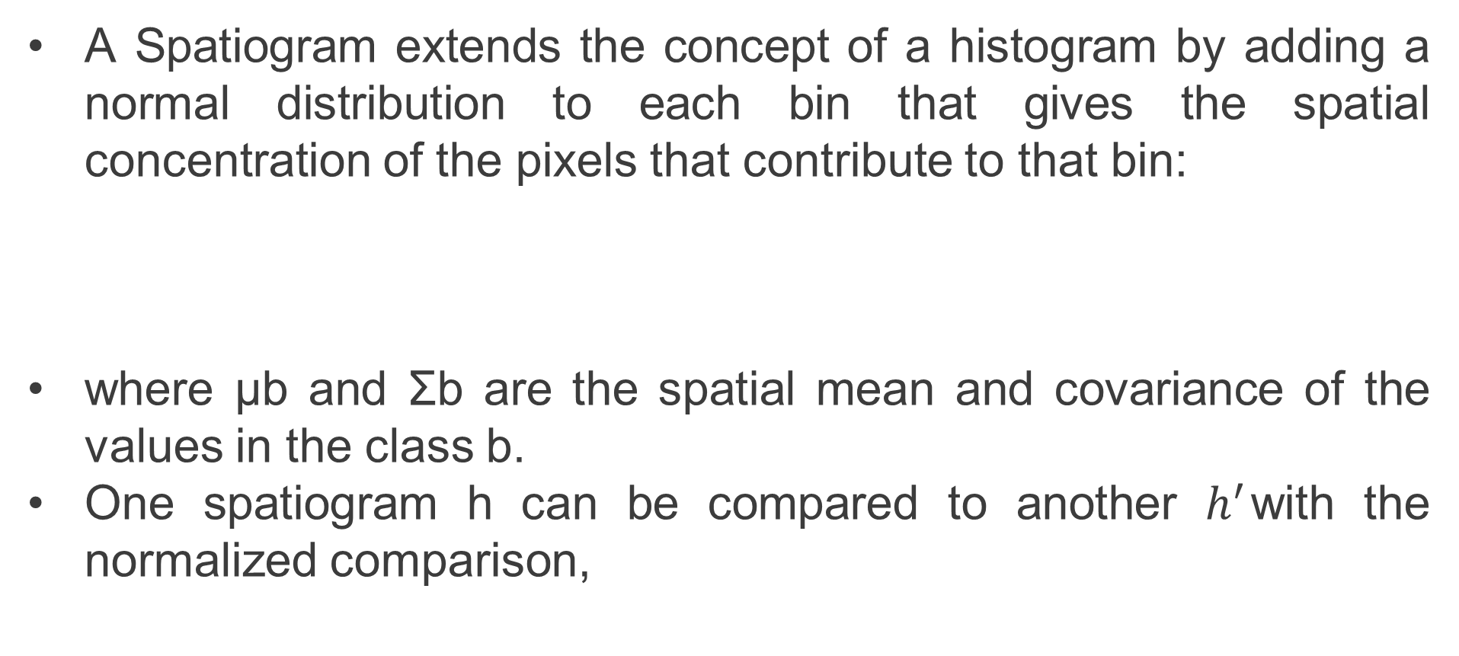
2.5 Video tracking- Learning landmarks
A Spatiogram extends the concept of a histogram by adding a normal distribution to each bin that gives the spatial concentration of the pixels that contribute to that bin:
where μb and Σb are the spatial mean and covariance of the values in the class b.
One spatiogram h can be compared to another $h^{′}$with the normalized comparison,

Slide 90

2.5 Video tracking- Learning landmarks
where the normalizing term ϕb is given as follows,
Returning to tracking: We will assume that target state consists of a location in the image, and we will calculate the spatial histogram on a fixed size region of the image centered on the target location.

Slide 91
2.5 Video tracking- Learning landmarks
The above definitions are for single channel, gray level spatiograms.
An easy way to extend to color spatiograms is by defining single channel spatiograms for each of the color channels of the image.

Slide 92
2.5 Video tracking- Learning landmarks
2.5.2 Condensation
The implementation of the CONDENSATION video tracking algorithm will look very similar to the implementation of the Monte Carlo Localization (MCL) localization.
We will need a motion model for the target.
If xt is the state of the target (its location and velocity in image coordinates, for example) then the condition distribution p(xt|xt−1) is our motion model.
We also need an observation model.
If we predict that the target has state xt then, when we measure the image at the location given by the state, and get a measurement zt, our observation model is the distribution p(zt|xt).

Slide 93

2.5 Video tracking- Learning landmarks
If h(xt) is the spatiogram presenting the target and zt is the spatiogram of the candidate region, then we can say,
An advantage of Condensation over other tracking methods is that it places little constraints on the motion and observation model except that they can be evaluated on each particle.
This advantage is bought at the cost of needing a large number of particles for accurate results.
This is also the reason it is a good choice for cluster implementation since, the operations on each particle are independent.

Slide 94
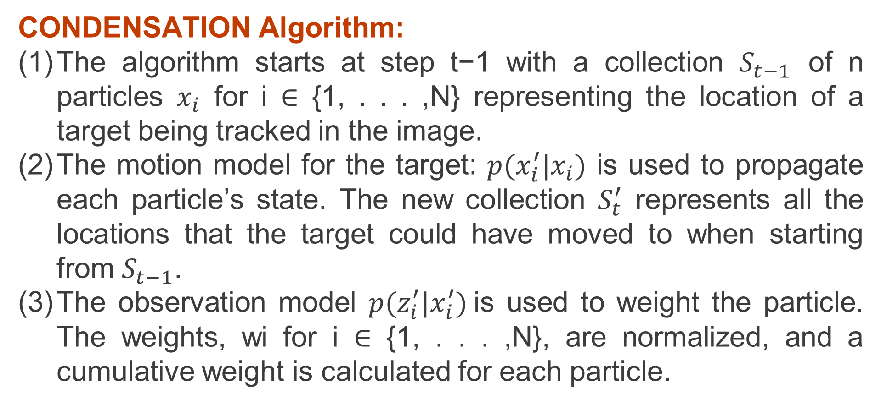
2.5 Video tracking- Learning landmarks
CONDENSATION Algorithm:
The algorithm starts at step t−1 with a collection $S_{t−1}$ of n particles $x_{i}$ for i ∈ {1, . . . ,N} representing the location of a target being tracked in the image.
The motion model for the target: $p(x_{i}^{′}|x_{i})$ is used to propagate each particle’s state. The new collection $S_{t}^{′}$ represents all the locations that the target could have moved to when starting from $S_{t−1}$.
The observation model $p(z_{i}^{′}|x_{i}^{′})$is used to weight the particle. The weights, wi for i ∈ {1, . . . ,N}, are normalized, and a cumulative weight is calculated for each particle.

Slide 95
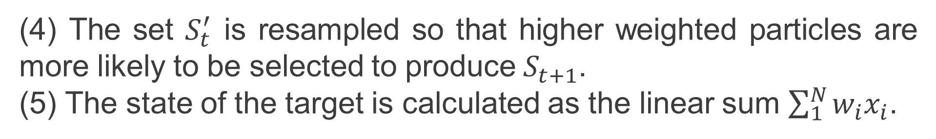
2.5 Video tracking- Learning landmarks
(4) The set $S_{t}^{′}$ is resampled so that higher weighted particles are more likely to be selected to produce${ S}_{t+1}$.
(5) The state of the target is calculated as the linear sum $\sum_{1}^{N}{w_{i}x_{i}}$.

Slide 96
2.5 Video tracking- Learning landmarks
Partitioning CONDENSATION Algorithm:
We can partition the condensation algorithm in a fashion similar to our scheme for MCL Localization.
We broadcast the n × m image to all p processors, and then partition the N samples equally among the p processors.
The communication cost is (λ+nm/β)log p for the broadcast, and λlog p + N(p − 1)/pβ for the particle scatter.
Each processor then propagates its N/p particles with the motion model.
It then calculates N/p spatiograms on fixed size regions around the locations of each particle.

Slide 97
2.5 Video tracking- Learning landmarks
Finally it carries out N/p spatiogram comparison operations between the spatiogram.
An alternative partition scheme is to partition the image by row strips, and broadcast all n particles.
Each processor calculates only the portion of propagations, spatiograms and comparisons that occur in its image strip.
Figure 2.5.2 shows that for smaller collections of particles (N = 10^4), for a fixed size (640 × 480) image, broadcasting particles and scattering the image has marginally smaller cost.
However, for larger collections of particles (N = 10^6), broadcasting the image and scattering the particles has the better performance.

Slide 98
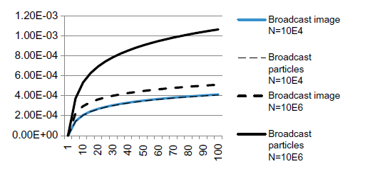
2.5 Video tracking- Learning landmarks
Figure 2.5.2: Performance comparison of condensation partitioning approaches.

Slide 99
2.5 Video tracking- Learning landmarks
We would prefer to work with larger collections of particles, since condensation produces a more accurate tracking in that
case.
But furthermore, scattering the image has the disadvantage that all the particles may end up in a small number of row stripes, leaving most processors idle.

Slide 100
2.6 Learning landmarks
Key purposes of for having the robot learn a map is to
1. allow it to localize (determine where it is).
2. carry out better motion planning by using knowledge about the space in which the motion will occur.
However, an issue with occupancy maps is that their storage requirements scale with the square of the area to be represented.
Even worse, much of this area may not be interesting or relevant for the tasks that the robot must carry out — it may simply be area through which the robot must pass to get to destination.

Slide 101
2.6 Learning landmarks
Consider your morning commute.
Unless you are lucky enough to work at home, you probably have to drive on some local roads from your house until you get to a larger road or highway.
From this, you sooner or later take an exit and proceed on some local roads to your place of work.
It is important to have good map information whenever you have to make a choice along this route: for example, switching between local roads, or to get on, or off, the highway.

Slide 102
2.6 Learning landmarks
A topological map: a graph-like collection of places. Each place is identified by sensory feature measurements (the place signature) and the places are linked together by routes without any absolute spatial measurements.
Your recollection of your daily commute may be a bit more like this topological map than like an occupancy-grid map, except for those places where you need to make decisions.
A reasonable approach to trade off the map storage requirements with map accuracy requirements is as follows:
Use a local metric map representation within places, but recognize places with sensory signatures, and store just the route connectivity information between places.

Slide 103
2.6 Learning landmarks
The route information allows the robot to navigate from one place to another.
However motor skills or other behaviors may be necessary to successfully navigate the transition from one place to another.
Consider the landscape shown in Figure 2.6.1(a): roads traverse the scene, but at places where road intersections occur, visual landmarks are noted.
These visual landmarks are the signatures for the places at which decisions need to be made.
An equivalent topological map is shown in Figure 2.6.1(b).

Slide 104
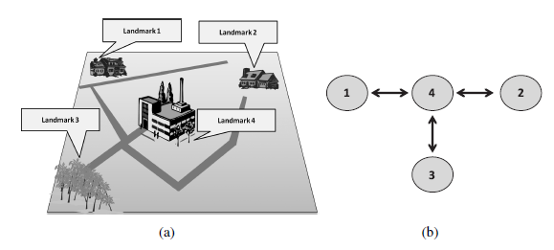
2.6 Learning landmarks
Figure 2.6.1: (a) Scene with landmarks, and (b) equivalent topological map.

Slide 105
2.6 Learning landmarks
The places are labeled with the landmark number.
The details of the routes between places are not represented, just the fact that one place is reachable from another.
The map can store more detailed metric information for each place.
For example, the map would have detailed information about the major intersection for the place labeled 4 in Figure 2.6.1.
Although any sensory signature could be involved in the identification of a place, we will restrict ourselves to looking at visual signatures.

Slide 106
2.6 Learning landmarks
Our objective will be to take multiple measurements of each of our landmarks and build a model (the signature) for each landmark.
When an image of an unknown landmark is presented to the robot, we would like it to use its collection of landmark models to determine to which, if any, of the landmarks the image corresponds.
This problem falls into the class of machine learning problems and is an example of what is called unsupervised learning.
Clustering (not to be confused with computational clusters) is an approach to solving unsupervised learning problems of this kind.

Slide 107
2.6 Learning landmarks
The clusters refer to subsets of the collection of data points in which all the members are ‘close’ to one another in some measurement space.
We will look at two fairly common approaches to clustering: 1. K-Means clustering
2. Expectation-Maximization (EM).

Slide 108
2.6.1 Landmark Spatiograms
Spatiograms were introduced to represent the visual similarity between a target candidate and a target.
We can also employ spatiograms to recognize landmarks
Consider Figure 2.6.2: Figure 2.6.2 column (a) shows images of three landmarks: a garbage bin, a wishing-well and a tree.
The images were taken with a stereocamera and the image foreground region identified by depth filtering.
The region is shown in the figures by the irregular image boundary on a black background.

Slide 109
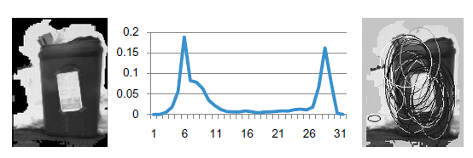
2.6.1 Landmark Spatiograms
Figure 2.6.2: (a) Landmark images, (b) Histograms (freq. vs. pixel values), (c) Spatial means.

Slide 110
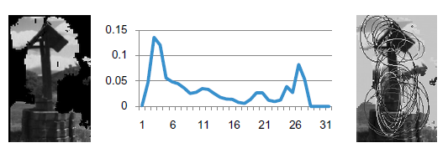
2.6.1 Landmark Spatiograms
Figure 8-2: (a) Landmark images, (b) Histograms (freq. vs. pixel values), (c) Spatial means.

Slide 111
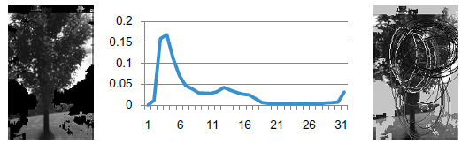
2.6.1 Landmark Spatiograms
Figure 8-2: (a) Landmark images, (b) Histograms (freq. vs. pixel values), (c) Spatial means.

Slide 112
2.6.1 Landmark Spatiograms
Spatiograms were calculated for each foreground region in Figure 8-2 column (a), and the normalized frequency information displayed as a histogram for each row in Figure 8-2 column (b).
The spatial mean and variance is displayed in Figure 8-2 column (c) as an ellipse with the spatial mean as center and (assumed independent) x and y variances as major and minor axis.
The brighter the contour of the ellipse, the higher the frequency value associated with that ellipse.

Slide 113
2.6.1 Landmark Spatiograms
Figure 2.6.3 shows three spatiograms of the same landmark from slightly different views.
There is a visible similarity between the shape of the three histograms, and also between the spatial areas that produce the highest frequency information (the white ellipses around the bucket and the well posts in Figure 2.6.2 column (c)).
Our approach to learning landmarks will be to take many examples of each landmark and to try to group these examples into clusters that are close together based on the spatiogram similarity measure ρ.

Slide 114
2.6.1 Landmark Spatiograms
When we are given candidate landmarks, we will be able to identify which landmark it is by determining into which cluster the spatiogram of the candidate falls.

Slide 115
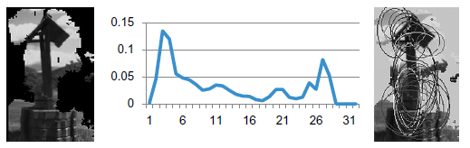
2.6.1 Landmark Spatiograms
Figure 2.6.3: (a) Landmark images, (b) Histograms, (c) Spatial means.

Slide 116
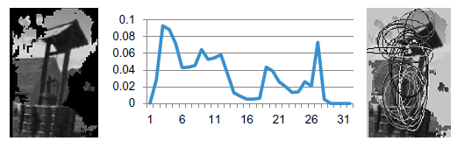
2.6.1 Landmark Spatiograms
Figure 2.6.3: (a) Landmark images, (b) Histograms, (c) Spatial means.

Slide 117
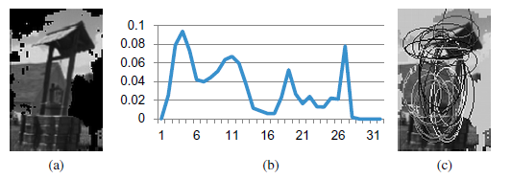
2.6.1 Landmark Spatiograms
Figure 2.6.3: (a) Landmark images, (b) Histograms, (c) Spatial means.

Slide 118
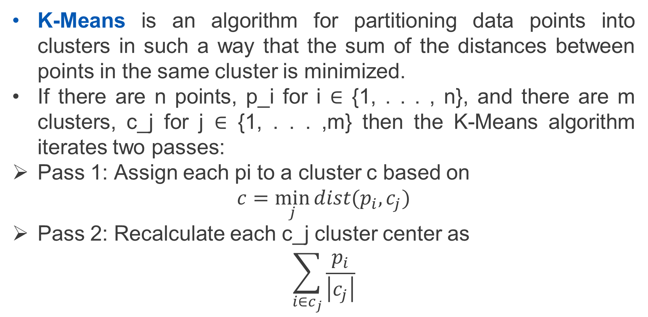
2.6.2 K-Means Clustering
K-Means is an algorithm for partitioning data points into clusters in such a way that the sum of the distances between points in the same cluster is minimized.
If there are n points, p_i for i ∈ {1, . . . , n}, and there are m clusters, c_j for j ∈ {1, . . . ,m} then the K-Means algorithm iterates two passes:
Pass 1: Assign each pi to a cluster c based on
$$c=\min_{j}{dist(p_{i},c_{j})}$$
Pass 2: Recalculate each c_j cluster center as
$$\sum_{i∈c_{j}}{\frac{p_{i}}{\left|c_{j}\right|}}$$

Slide 119
2.6.2 K-Means Clustering
The iteration can stop when the cluster centers in Pass 2 no longer change.
If each point is actually a spatiogram, then the distance measure that we need to use is ρ and the recalculation of cluster centers is an averaging of spatiograms.
A good selection of initial cluster center locations is typically important.
One approach is to select points that have the largest sum of distances from all other points as the initial cluster center locations.

Slide 120
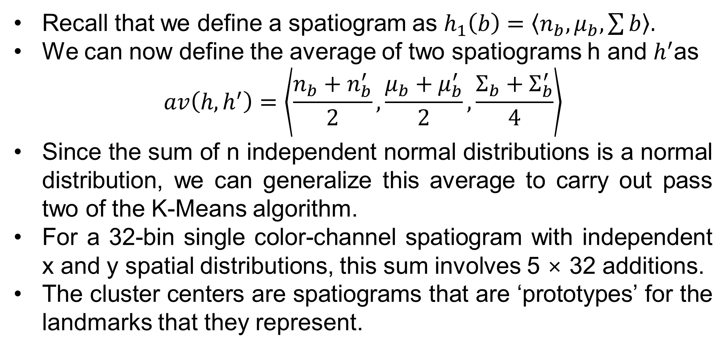
2.6.2 K-Means Clustering
Recall that we define a spatiogram as $h_{1}\left(b\right)=\left\langle n_{b},μ_{b}, \sum{b}\right\rangle .$
We can now define the average of two spatiograms h and $h^{′}$as
$$av\left(h,h^{′}\right)=\left\langle \frac{n_{b}+n_{b}^{′}}{2},\frac{μ_{b}+μ_{b}^{′}}{2},\frac{Σ_{b}+Σ_{b}^{′}}{4}\right\rangle$$
Since the sum of n independent normal distributions is a normal distribution, we can generalize this average to carry out pass two of the K-Means algorithm.
For a 32-bin single color-channel spatiogram with independent x and y spatial distributions, this sum involves 5 × 32 additions.
The cluster centers are spatiograms that are ‘prototypes’ for the landmarks that they represent.

Slide 121
2.6.2 K-Means Clustering
The cluster to point distances are all calculated independently in K-Means.
There is therefore the opportunity to carry out this phase in parallel.
Typically m<<n, that is, there will be much fewer clusters than points.
In terms of landmark clustering: we will have many example images (image spatiograms) of a small number of landmarks (cluster spatiograms).
Hence, we should broadcast the cluster spatiograms and scatter the image spatiograms.

Slide 122
2.6.2 K-Means Clustering
The image spatiograms only have to be scattered once (before the first iteration); the cluster spatiograms need to be rebroadcast on every iteration (since the cluster centers may move on every iteration).
Each processor will calculate the m distances for its n/p image spatiograms and record the cluster chosen for each image spatiogram — concluding the first pass.
Each processor will then sum all the image histograms for each cluster and participate in a reduction by sum on each cluster spatiogram.
The root completes the averaging for all clusters and rebroadcasts the results.

Slide 123
2.6.2 K-Means Clustering
The serial implementation of K-Means carries out the averagePoints and averageClusters routines for all the data points on each iteration.
If the time to carry out the spatiogram comparison is χ1 then assigning points takes time nmχ1.
If the time to add spatiograms is χ2 then the time to average the clusters is m(n/m)χ2 assuming an average of n/m points per cluster.
The serial time is given by Tser = n(mχ1 + χ2).
In the parallel implementation, the same calculations need to be
performed for n/p points (simplifying to the case where p divides n evenly).

Slide 124

2.6.2 K-Means Clustering
The calculation time is Tcal = n(mχ1 + χ2)/p.
The scattering is just done once, when K-Means initializes, so we will not count its contribution to the parallel time.
However, in each iteration, the broadcast and the reduce operations need to be performed for all clusters.
The communication time is Tcom = 2(λ+ms/β) log p.
Hence, the total parallel time is,

Slide 125

2.6.2 K-Means Clustering
Let the serial time be c and the parallel communication time be k.
In that case, the speedup can be written as,
If the ratio k/c > 0 then the speedup is less than linear ψ < p; the smaller the k/c ratio the closer the speedup is to linear.

Slide 126

2.6.2 K-Means Clustering
Looking at the k/c ratio for this problem, we have,
Surprisingly the number of clusters is not as significant to the speedup as the number of data points.
This ratio tells us that speedup will improve as the number of points increases.

Slide 127
2.6.3 EM Clustering
A second common algorithm used to assign points to clusters is Expectation-Maximization or EM.
EM tries to find a mixture of Gaussian functions that cluster the data points.
It differs from K-Means in that it doesn’t make a ‘hard’ assignment of each data point to a cluster.
Instead, data points can have degrees of membership in every cluster.
Since each cluster is a Gaussian, it is characterized not just by a center (the mean) by also by a variance.
EM can also be described as a two-pass iterative method and it is quite similar to K-Means in structure.

Slide 128
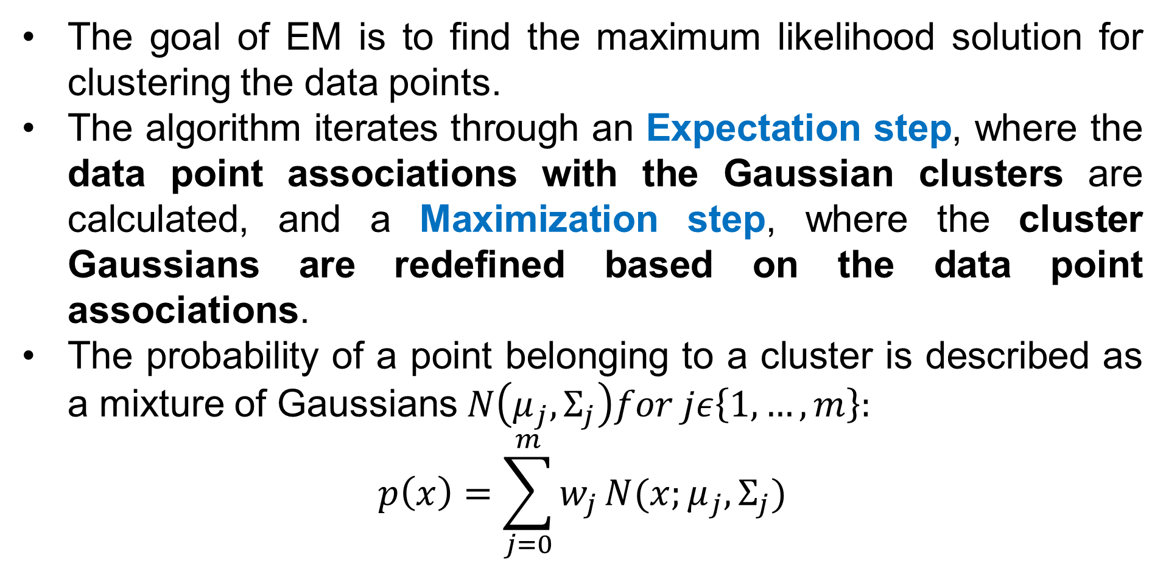
2.6.3 EM Clustering
The goal of EM is to find the maximum likelihood solution for clustering the data points.
The algorithm iterates through an Expectation step, where the data point associations with the Gaussian clusters are calculated, and a Maximization step, where the cluster Gaussians are redefined based on the data point associations.
The probability of a point belonging to a cluster is described as a mixture of Gaussians $N\left(μ_{j},Σ_{j}\right)for jε\left\{1,…,m\right\}:$
$$p\left(x\right)=\sum_{j=0}^{m}{w_{j}}N(x;μ_{j},Σ_{j})$$

Slide 129

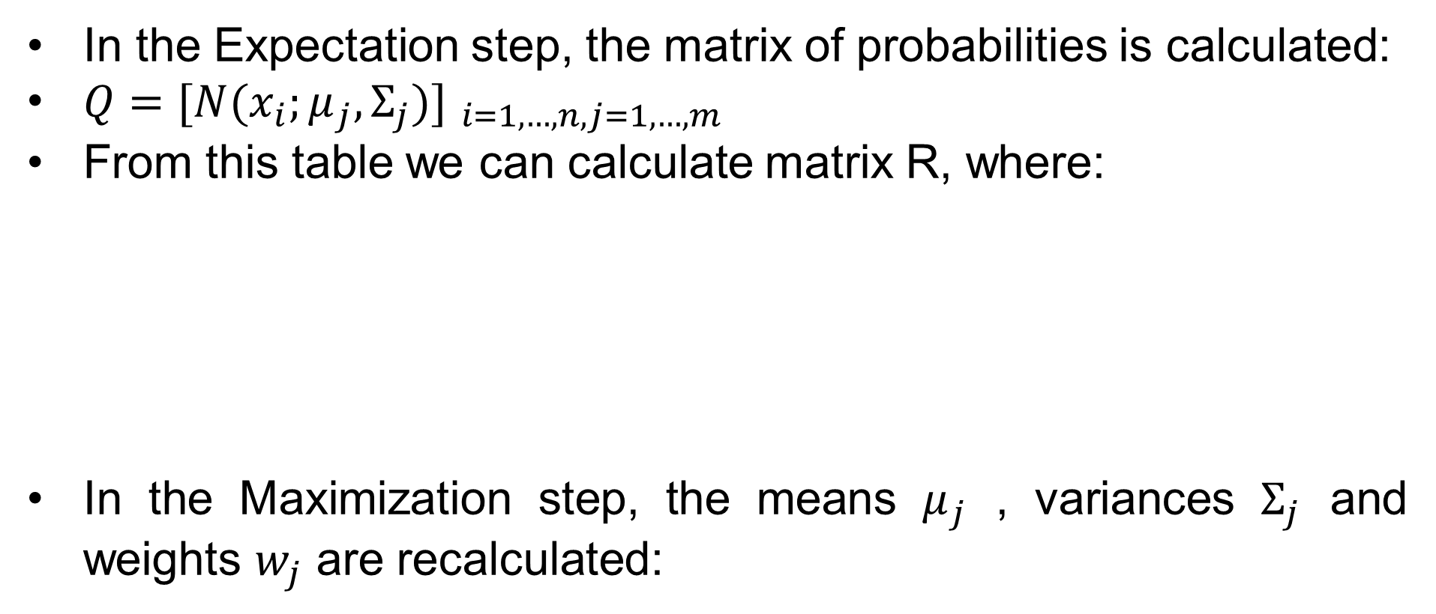
2.6.3 EM Clustering
In the Expectation step, the matrix of probabilities is calculated:
$Q={[N(x_{i};μ_{j},Σ_{j})] }_{i=1,…,n, j=1,…,m}$
From this table we can calculate matrix R, where:
In the Maximization step, the means $μ_{j}$ , variances $Σ_{j}$ and weights $w_{j}$ are recalculated:

Slide 130
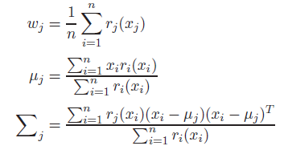
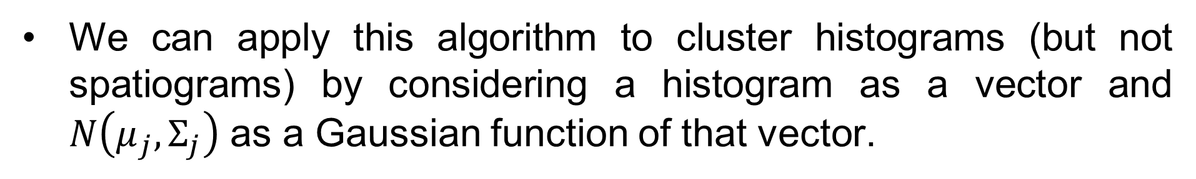
2.6.3 EM Clustering
We can apply this algorithm to cluster histograms (but not spatiograms) by considering a histogram as a vector and $N\left(μ_{j},Σ_{j}\right)$ as a Gaussian function of that vector.

Slide 131
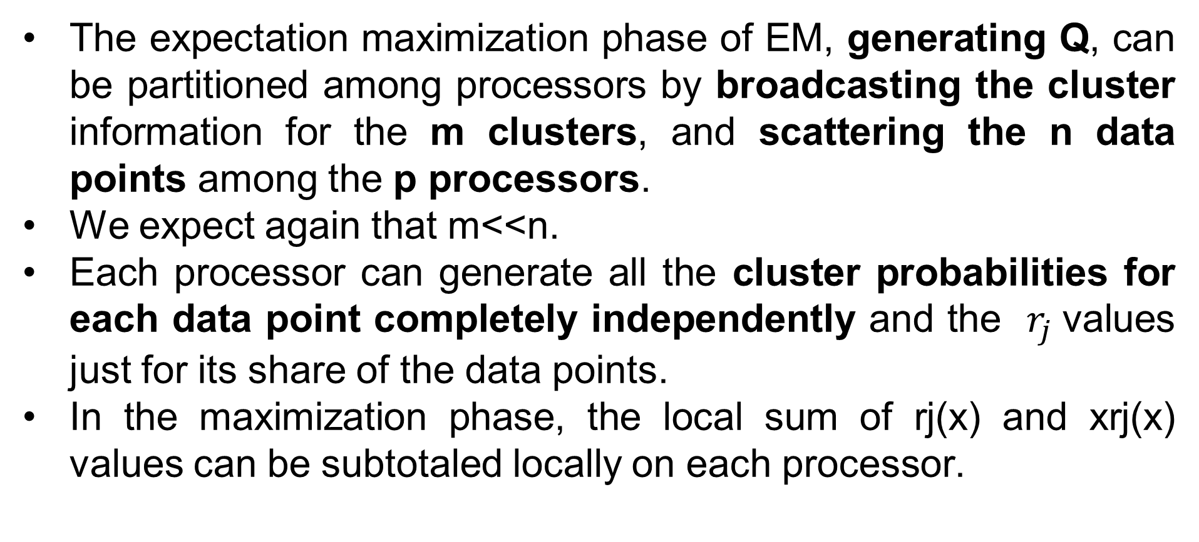
2.6.3 EM Clustering
The expectation maximization phase of EM, generating Q, can be partitioned among processors by broadcasting the cluster information for the m clusters, and scattering the n data points among the p processors.
We expect again that m<<n.
Each processor can generate all the cluster probabilities for each data point completely independently and the $r_{j}$values just for its share of the data points.
In the maximization phase, the local sum of rj(x) and xrj(x) values can be subtotaled locally on each processor.

Slide 132
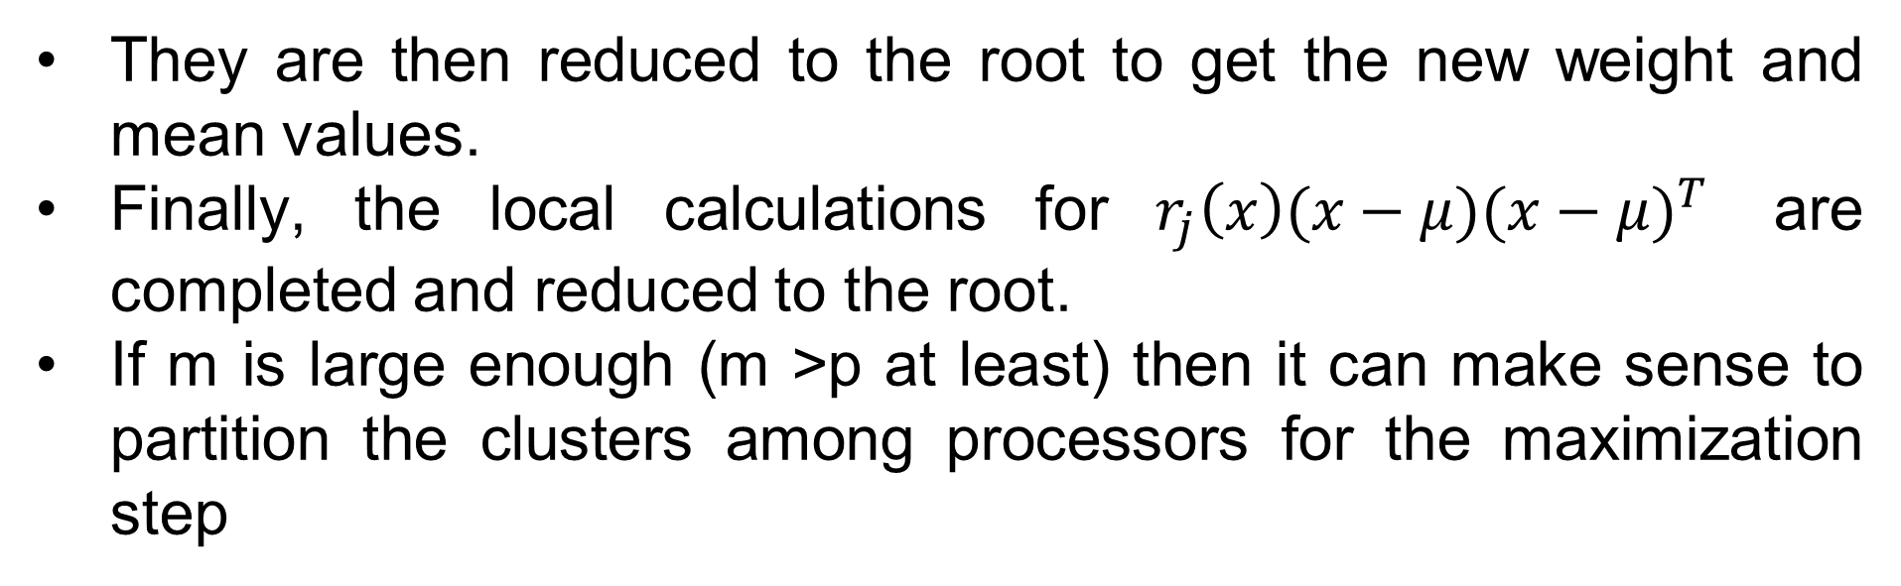
2.6.3 EM Clustering
They are then reduced to the root to get the new weight and mean values.
Finally, the local calculations for $r_{j}\left(x\right)(x−μ){(x−μ)}^{T}$ are completed and reduced to the root.
If m is large enough (m >p at least) then it can make sense to partition the clusters among processors for the maximization step

Slide 133

2.6.3 EM Clustering
Analysis:
The time performance of EM has a similar form to that of K-Means.
The serial time is given by:
where nmχ1 is the time to calculate the Q matrix while mnχ2 is the time to sum the R matrix columns and calculate the new weights, means and variances.
The expectation step has no communication needs. Hence, this can be partitioned among the cluster processors with (in the case p divides n evenly) nχ1/p time.

Slide 134

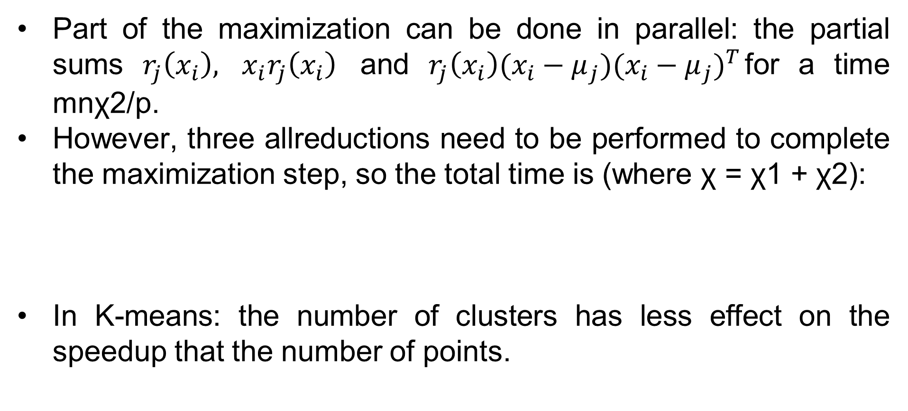
2.6.3 EM Clustering
Part of the maximization can be done in parallel: the partial sums $r_{j}\left(x_{i}\right),$ $x_{i}r_{j}\left(x_{i}\right)$ and $r_{j}\left(x_{i}\right)(x_{i}−μ_{j}){(x_{i}−μ_{j})}^{T}$for a time mnχ2/p.
However, three allreductions need to be performed to complete the maximization step, so the total time is (where χ = χ1 + χ2):
In K-means: the number of clusters has less effect on the speedup that the number of points.

Slide 135
Module 2: The End

